Slide 1
LECTURE # 13
TREE

Slide 2


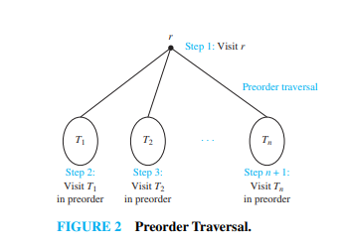

Slide 3
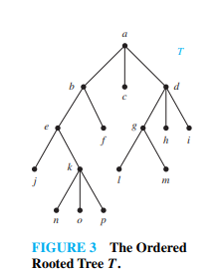
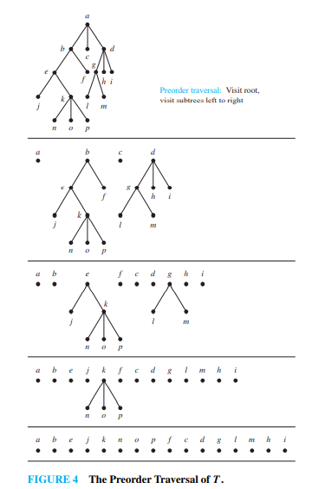

Slide 4

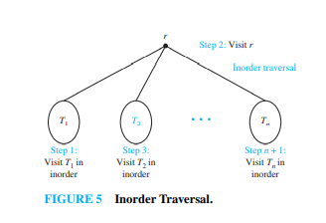

Slide 5
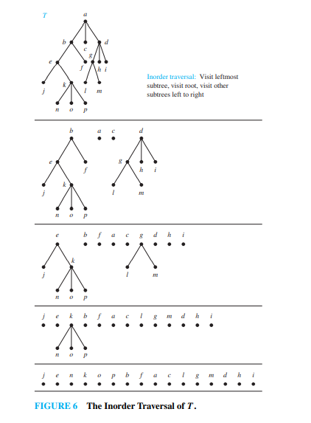

Slide 6
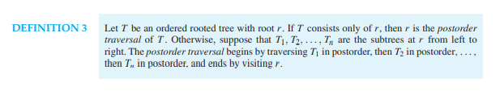
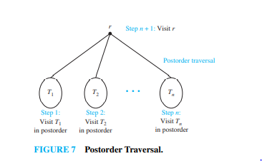

Slide 7
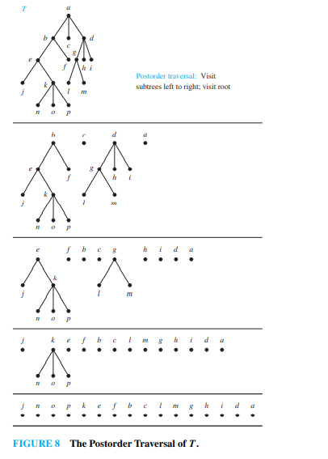

Slide 8
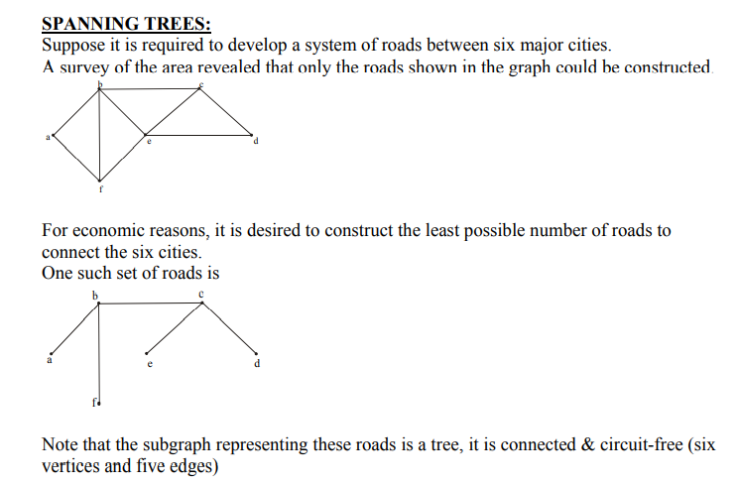

Slide 9
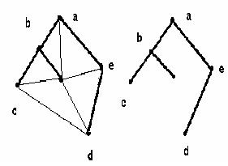
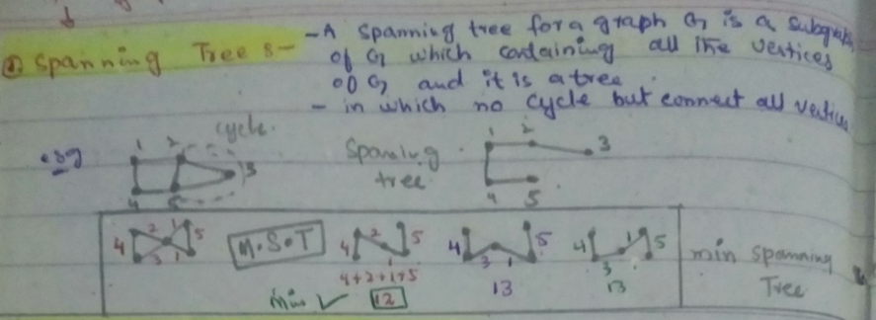
Spanning trees
Given a graph G, a tree T is a spanning tree of G if:
T is a subgraph of G
T contains all the vertices of G

Slide 10
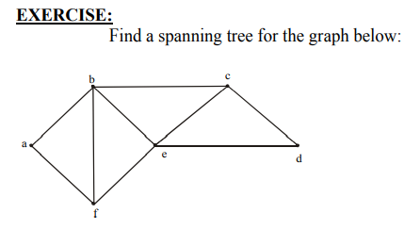
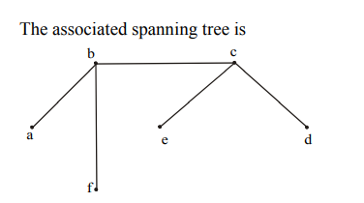
SOLUTION:
The graph has 6 vertices (a, b, c, d, e, f) & 9 edges so we must delete.
5 edges (as we have studied that a tree of vertices n has n-1 edges(6-1)).
We delete an edge in each cycle.
1. Delete af 2. Delete fe
3. Delete be 4. Delete ed
Note it that we can construct road from vertex a to b, but can’t go from “a to e”, also
from “a to d” and from “a to c “, because there is no path available.

Slide 11
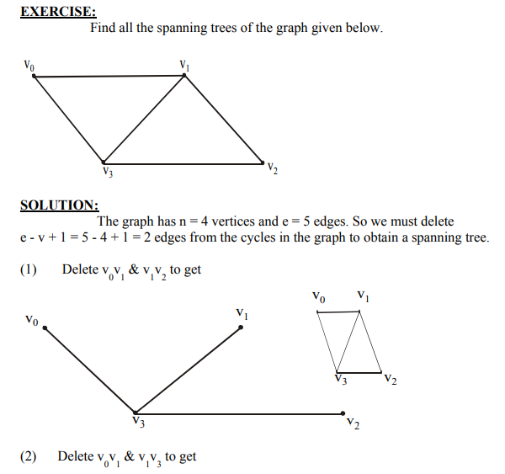
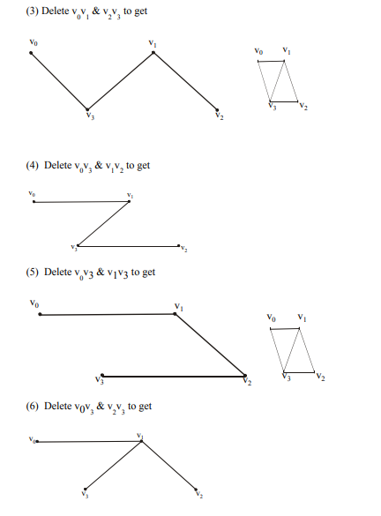
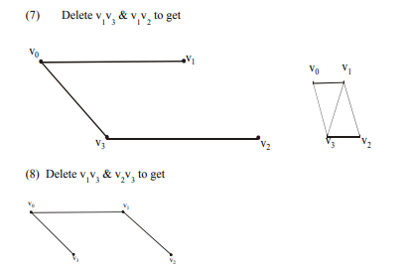
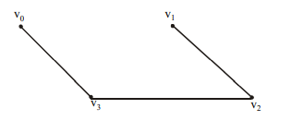

Slide 12
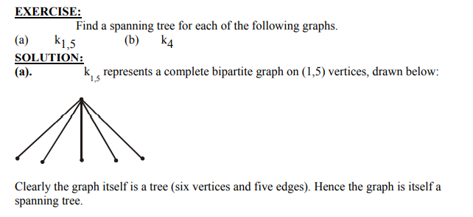
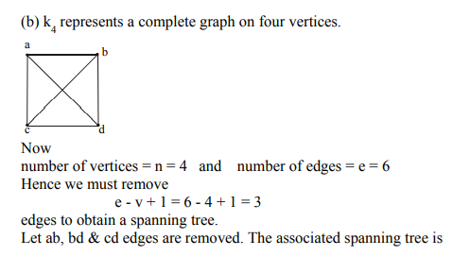
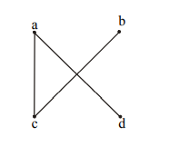

Slide 13
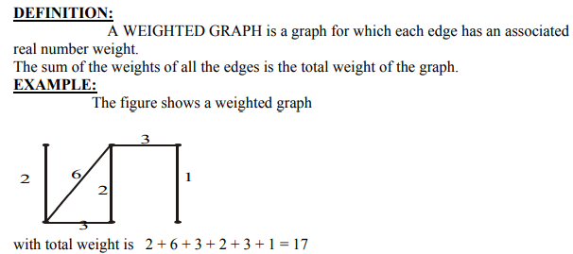

Slide 14
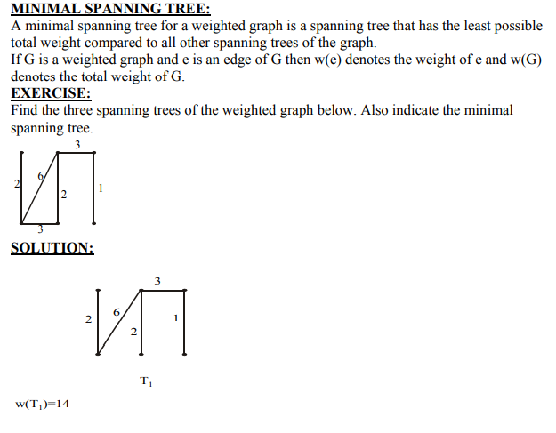
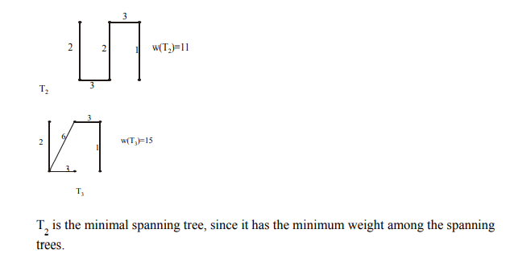

Slide 15
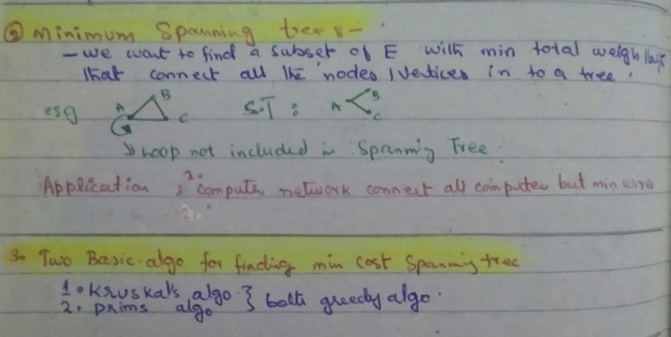

Slide 16
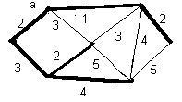
1. Prim’s algorithm
Step 0: Pick any vertex as a starting vertex (call it a). T = {a}.
Step 1: Find the edge with smallest weight incident to a. Add it to T Also include in T the next vertex and call it b.
Step 2: Find the edge of smallest weight incident to either a or b. Include in T that edge and the next incident vertex. Call that vertex c.
Step 3: Repeat Step 2, choosing the edge of smallest weight that does not form a cycle until all vertices are in T. The resulting subgraph T is a minimum spanning tree.

Slide 17
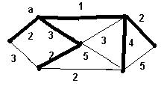
2. Kruskal’s algorithm
Step 1: Find the edge in the graph with smallest weight (if there is more than one, pick one at random). Mark it with any given color, say red.
Step 2: Find the next edge in the graph with smallest weight that doesn't close a cycle. Color that edge and the next incident vertex.
Step 3: Repeat Step 2 until you reach out to every vertex of the graph. The chosen edges form the desired minimum spanning tree.

Slide 18
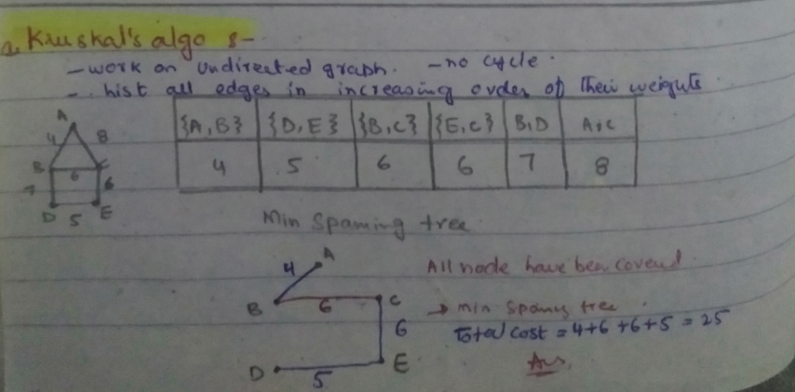

Slide 19
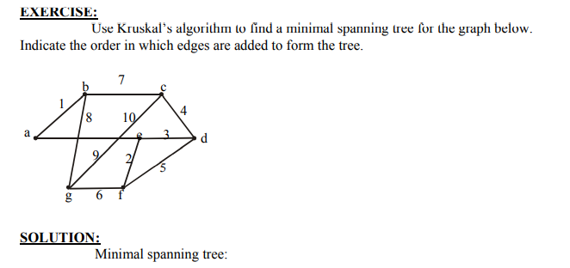
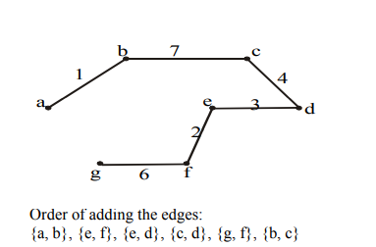

Slide 20
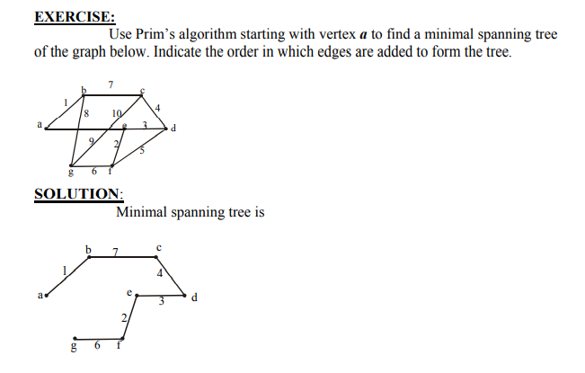


Slide 21
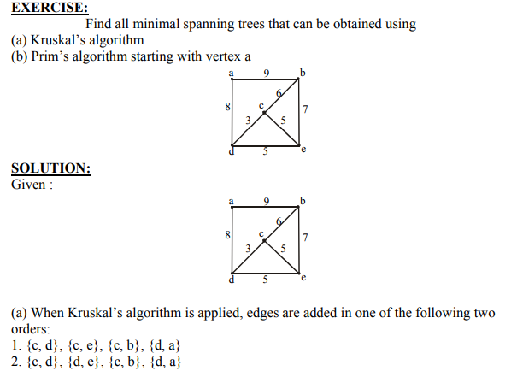

Slide 22
